Slide 1

EMC Requirements of
Federal Communications Commission
Richard Lu

Slide 2
Content
Definition
Code of Federal Regulations Title 47
Others Common Standards
Brief of Parts
CFR47 Part 2
CFR47 Part 15
CFR47 Part 18
CFR47 Part 68
Mutual Recognition Agreements (MRAs) overview and status
Regulatory Procedures Update
Procedure and Document
FAQ

Slide 3
Definition
FCC: Federal Communications Commission
NIST: National Industry Standard Technology Institute
TIA: Technical Industry Admin
EIA: Electronic Industry Admin
TCB: Telecommunication Certification Body
OET: Office of Engineering and Technology
NVLAP: National Voluntory Laboratory Accreditation Program
A2LA: American Association for Laboratory Accreditation
MRA: Mutual Recognition Agreement
CB: Citizen Band

Slide 4

Code of Federal Regulations Title 47

Slide 5
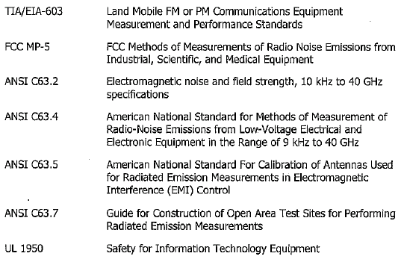
Others Common Standards

Slide 6
Brief of Parts
Part 15
Unintentional Radiators
Computers, Computer peripherals, Receivers, Telephones
Part 15
Intentional Radiators
Radio Controlled Devices, Cordless Telephones, Car Alarm Transmitters, Spread Spectrum Transmitters, 802.11 Devices, UNII, Walkie-Talkies, Wireless Video Devices, Wireless LAN's
Part 18
Industrial, Scientific & Medical devices
Electronic ballast, Microwave Ovens
Part 22
Paging Equipment
Rural Radio
Part 24
Personal Communication Services

Slide 7
Brief of Parts
TIA,EIA,IS-968
Modems, Telephones, ICLID's Alarm Dialers, Alarm Systems (part 68), PBX's
Part 74
Broadcast Radio, Aural Broadcast, STL's, Low Power Auxiliary Transmitters, Wireless Microphones
Part 80
Marine Radios, Marine Radars
Part 87
Aeronautical Ground stations - Unicom's -DME's
Part 90
Business band Radios
Special Emergency Radios
Wireless Microphones
Remote Control Transmitters

Slide 8
Brief of Parts
Part 95
CB Radios, Family Radio Services (FRS), General Mobile Radio Services (GMRS), 218-219MHz Subpart F, Low Power Radio Services (LPRS) Subpart G, Wireless Medical Telemetry Service (WMTS) Subpart H, Medical Implant Communications (MICS) Subpart I , Multi-User Radio Service (MURS) Subpart J
Part 97
Amateur Radio, Amplifiers
Part 101
Fixed Microwave Services

Slide 9

CFR47 Part 2
Frequency allocations and radio treaty matters; general rules and regulations
  Frequency allocation and radio treaty matters
  General rules
  Regulation

Slide 10
CFR47 Part 2
Verification: 2.902
    Scope: most unintentional radiators;
    Procedure(refer to Regulatory Procedures Update)
Declaration of Comformity: 2.906
    Scope: Primarily for computing equipment;
    Procedure: (refer to Regulatory Procedures Update)
Certification: 2.907
    Scope: all intentional radiators;
    Procedure: (refer to Regulatory Procedures Update)

Slide 11
CFR47 Part 2
The summary: Type of Approval
Type of Approval | Devices
Verification | Class A(business) computer equipment, TV and FM receiver, Non-consumer industrial, sceintific medical equipment
Declaration of Comformity | Personal computer equipment and peripherals(Class B) , CB receivers, super-regenerative receivers, Part 15 receicers, TV interface devices, cable system terminals devices and consumer ISM equipment
Certification | Personal computing equipment and peripherals , VCRs, Cordless telephones, garage door openers, scanning and super-regenerative receivers, AM, FM and TV transmitters, point-to-point microwave auxiliary broadcast receivers and other receivers, radio equipment in licensed radio service such as cellular phone equipment, land mobile transmitters, police/fire transmitters, citizen’s band radios, consumer ISM equipment

Slide 12
CFR47 Part 15
Subject A General
Subject B Unintentional Radiators;
Subject C Intentional Radiator;
Subject D Unlicensed Personal Communications Service Devices
Subject E Unlicensed National Information Infrastructure Devices
Subject F Ultra-Wideband Operation

Slide 13
CFR47 Part 18
Subpart A: general information and definitions;
Subpart B: procedures and requirements for authorization to market or operate ISM equipment under this part;
Subpart C: the technical standards for ISM equipment.

Slide 14
CFR47 Part 68
Connection of terminal equipment to the telephone network
Subject A– General
Subject B– Conditions on Use of Terminal Equipment
Subject C– Registration Procedures
Subject D– Conditions for Registration
Subject E– Complaint Procedures
Subject F– Connectors

Slide 15

Mutual Recognition Agreements (MRAs) overview and status

Slide 16
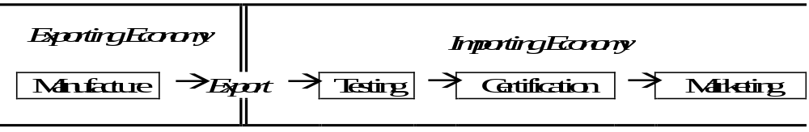
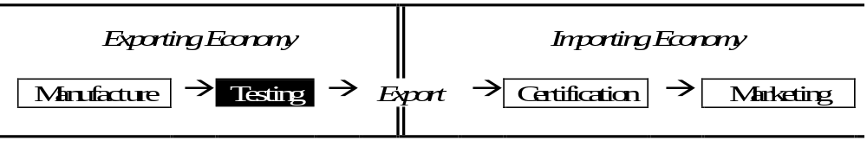

Mutual Recognition Agreements (MRAs) overview and status
Before MRAs
Mutual Recognition of Test Reports (Phase I)
Mutual Recognition of Certification (Phase II)

Slide 17
Regulatory Procedures Update
Through CAB
    Through the accredited testing Lab;
        Verification;
        DOC;
    Through TCB
        Verification, DOC and Certification
        Verify TCB Scope
Through FCC
    All products

Slide 18
Procedure and Document
Through the CAB;
  He is TCB, His lab is a accredited lab;
  He accepted the test result from the FCC listed lab.
  His scope: A1,A2,A3,A4,B1,B2,B3,B4 https://gullfoss2.fcc.gov/oet/tcb_index.html

Slide 19
Procedure and Document
Document:
For DoC and Verification:
Block Diagram
External Photos
FCC Label and Location Info
Internal Photos
Operational Description
Schematics
User Manual
Parts List (only for internal control)
PCB layout (only for internal control)

Slide 20
Procedure and Document
Document:
For Part 15 ID normal application
Block Diagram
External Photos
FCC Label and Location Info
Internal Photos
Operational Description
Schematics
User Manual
filled-in Form 731
Cover Letter with Request for Confidentiality (if Confidentiality is desired)
Parts List (only for internal control)
PCB layout (only for internal control)

Slide 21

FAQ
Pricing:
The contract with EMCC:

Slide 22

Thank You for coming
to our Seminar !

